Slide 1
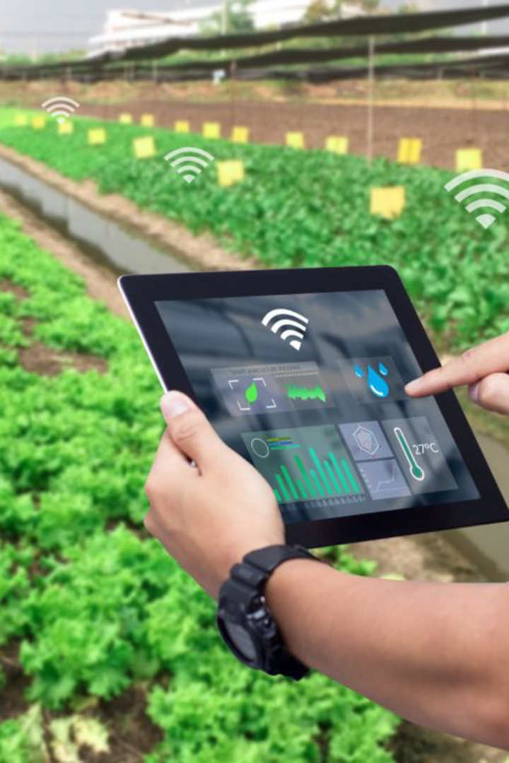
Revolutionizing Agriculture with IoT
Welcome to the future of farming presented by (Team Name) comprised of (Member Names). As we embrace the technological era, we proudly present a ground-breaking solution poised to revolutionize agriculture with Internet of Things (IoT) advancements. Anticipate a seamless integration of the latest IoT innovations crafted to address and transform traditional agricultural practices. Join us as we unfold the potentiality of smart farming where efficiency meets sustainability.

Slide 2

Team Introduction
Our team is made up of individuals who are passionate about both technology and agriculture. We believe that by combining these two fields, we can make significant strides towards improving agriculture globally. Together, we are committed to developing innovative solutions that address the challenges faced by farmers around the world. We believe that by working towards these goals, we can help to create a more prosperous and equitable future for all.
Shashank Naik
Team Leader
SE EXTC
.
Yash Doke
SE EXTC
Tanishq Patel
SE EXTC
Rujul Pawar
SE EXTC
Smit Asher
SE EXTC
Varun Choudhary
SE EXTC

Slide 3
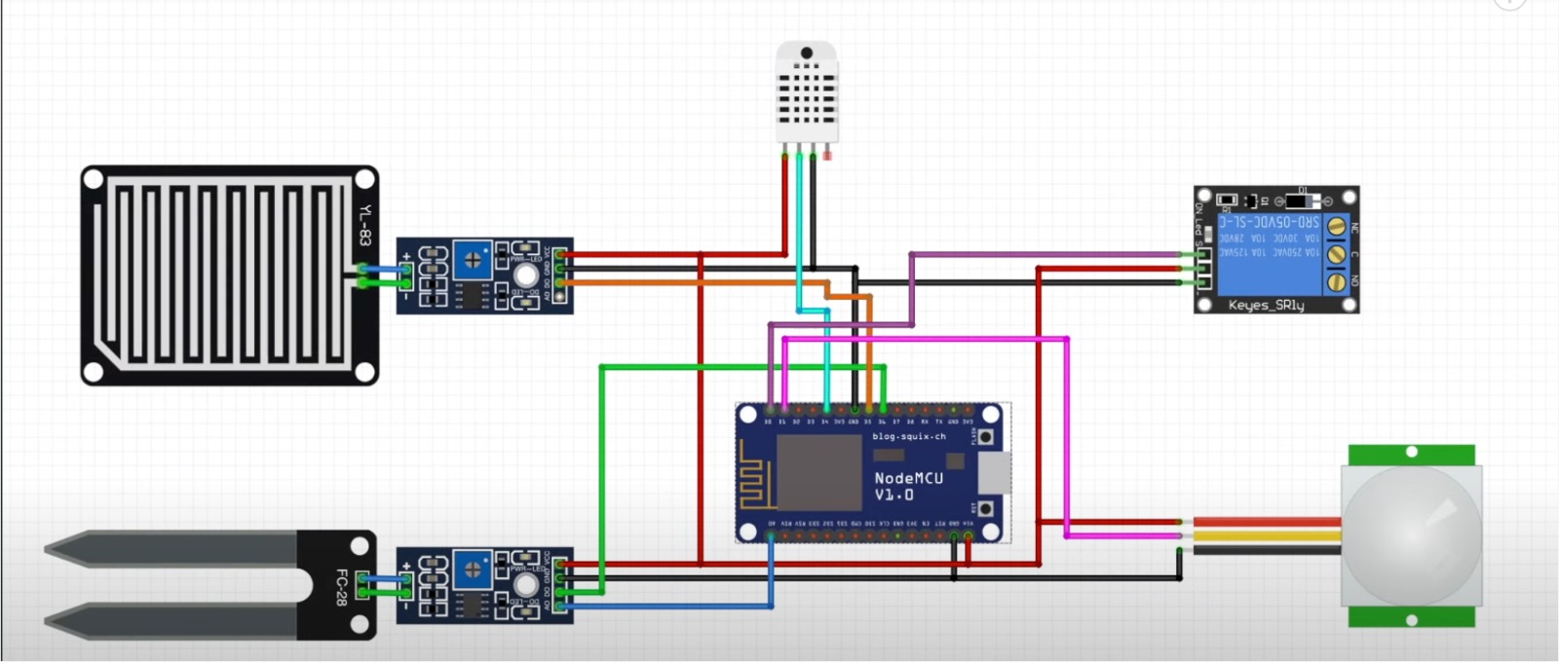
The Problem Statement
1
We addressed the pressing challenge of enhancing crop yields, sustainable resource management, and the empowerment of small-scale farmers in an increasingly demanding market. By addressing these and other challenges in agriculture, IoT solutions can help farmers increase efficiency, reduce input costs, minimize environmental impact, and ensure food security for a growing global population.
2
Smart Solution Teaser
.

Slide 4


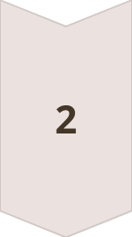
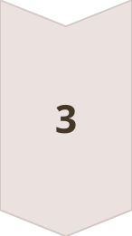
Addressing Agricultural Challenges
Environmental Stresses
Eroding soil health, water scarcity, and unpredictable climatic conditions are accelerating the need for resilient agricultural practices.
Resource Optimization
The imperative to optimize resources, reducing wastage while enhancing crop quality and quantity, stands at the forefront of modern farming challenges.
Innovation Necessity
Highlighting the crucial role that innovative technologies like IoT play in addressing these obstacles and paving the way for a sustainable agricultural future.

Slide 5
The Importance of Innovative Solutions
Imaginative arrangements are significant for tending to modern challenges over different spaces, counting innovation, healthcare, environment, instruction, and past. Here's a emphasis of their significance:
Issue Understanding:
Inventive arrangements empower us to handle complex issues viably. They empower considering exterior the box and finding novel approaches to longstanding issues.
Competitive Advantage:
In today's fast-paced world, development is frequently the key to remaining ahead of the competition. Businesses that reliably improve are way better situated to adjust to changing advertise conditions and meet advancing client needs
Proficiency and Efficiency:
Imaginative arrangements frequently streamline forms, making them more proficient and beneficial. This may lead to taken a toll reserve funds, time investment funds, and moved forward in general execution.
Imagination and Motivation :
Advancement cultivates imagination and motivates others to think inventively as well. By exhibiting what is conceivable through advancement, we energize a culture of imagination and ceaseless advancement.
Flexibility:
Imaginative arrangements regularly give versatility within the confront of instability. They permit organizations and people to adjust to changing circumstances and overcome deterrents more successfully.
In outline, imaginative solutions are not fair alluring but basic for tending to the complex challenges of our time, driving advance, and building distant better; a much better; a higher; stronger; an improved">a distant better future for eras to come.

Slide 6
Our IoT-Based Agriculture Solution Overview
Direct Challenges Addressed
Solution Blueprint
Our solution strategically tackles challenges such as water misuse, inefficient fertilization, and pest control, significantly enhancing overall farm productivity.
Introducing an architecturally sound and technologically advanced system capable of real-time monitoring, data analysis, predictive maintenance, and more.
Our IoT-based agriculture solution integrates sensors, actuators, and data analytics to optimize farming processes. It collects real-time data on soil moisture, temperature, humidity, and light levels, allowing farmers to make informed decisions about irrigation, fertilization, and crop health. Through a user-friendly interface, farmers can remotely monitor field conditions, receive alerts, and automate irrigation systems based on preset thresholds. The solution enhances crop yield, conserves resources, and improves overall farm efficiency, empowering farmers with actionable insights for sustainable agriculture practices.

Slide 7
Highlight Of the Identified Challenges
Our IoT-based agriculture solution directly addresses key challenges faced by farmers:
1. Data-Driven Decision Making: By collecting real-time data on soil conditions, weather patterns, and crop health, farmers can make informed decisions about irrigation, fertilization, and pest management.
2. Resource Conservation: Through precise monitoring and control of irrigation systems, our solution helps conserve water and energy by avoiding overwatering and optimizing resource usage based on actual crop needs.
3. Remote Monitoring and Management: Farmers can remotely monitor field conditions and receive alerts about potential issues such as soil moisture depletion or temperature fluctuations, allowing for timely intervention and problem resolution.
4. Increased Efficiency and Yield: With automated processes and predictive analytics, farmers can optimize their farming practices, leading to increased crop yields, improved quality, and reduced operational costs.
5. Sustainability: By promoting data-driven precision agriculture techniques, our solution supports sustainable farming practices by minimizing environmental impact and maximizing resource efficiency over the long term.

Slide 8
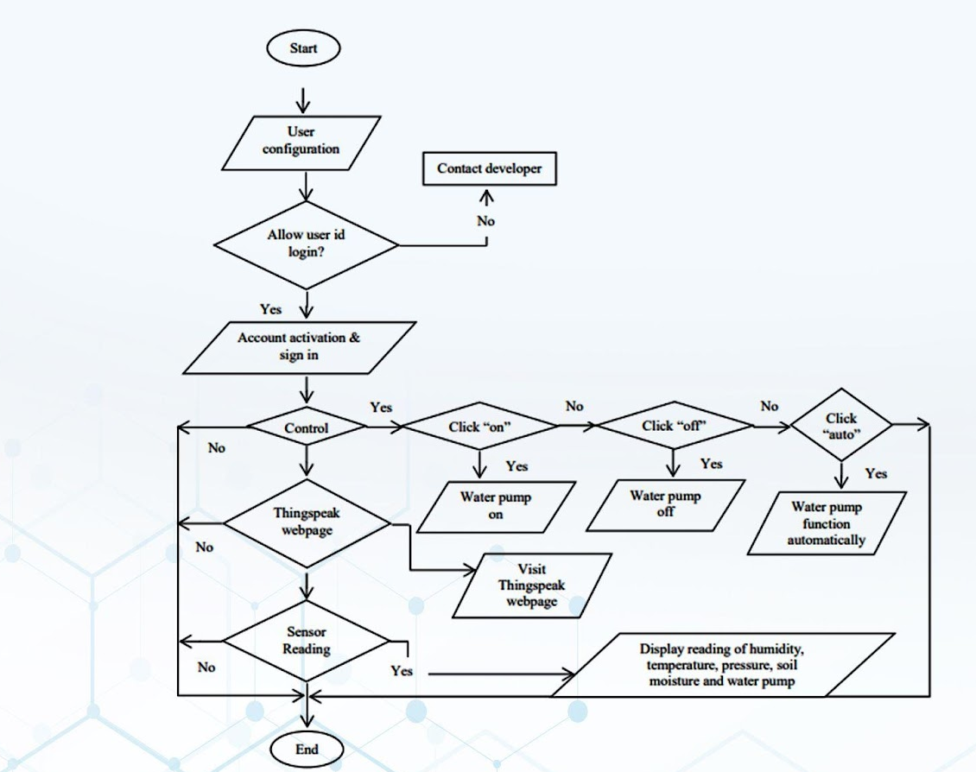
System Architecture

Slide 9
Key Components Breakdown
Components | Description | Price in Rs
Sensors | DHT11 | 200
 | Rain Sensor module | 70
 | LCD Display (2*16) | 100
 | SPST Relay Module | 105
 | ESP32 | 350
 | Moisture Sensor | 50
 | PIR Motion Sensor | 60
 | Dc motor 12V | 120
 | Water pump | 200
 | Buzzer | 20

Slide 10
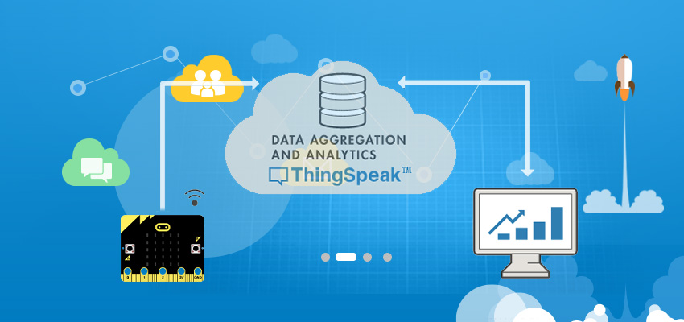
Data Analytics Platform
ThingSpeak
ThingSpeak is an Internet of Things (IoT) platform that enables users to collect, analyze, and visualize data from sensors or devices.
It provides cloud-based storage for time-series data, offering RESTful APIs for easy integration with IoT devices and applications.
With built-in MATLAB analytics capabilities, users can perform complex data analysis and visualization tasks.
ThingSpeak supports real-time data streaming and allows users to create custom dashboards for monitoring and tracking various IoT metrics.
It's widely used in IoT projects for remote monitoring, environmental sensing, and industrial automation.

Slide 11

User Interface
Arduino Ide
Arduino IDE is an open-source software, designed by Arduino.cc and mainly used for writing, compiling & uploading code to almost all Arduino Modules. It is an official Arduino software, making code compilation too easy that even a common person with no prior technical knowledge can get their feet wet with the learning process

Slide 12
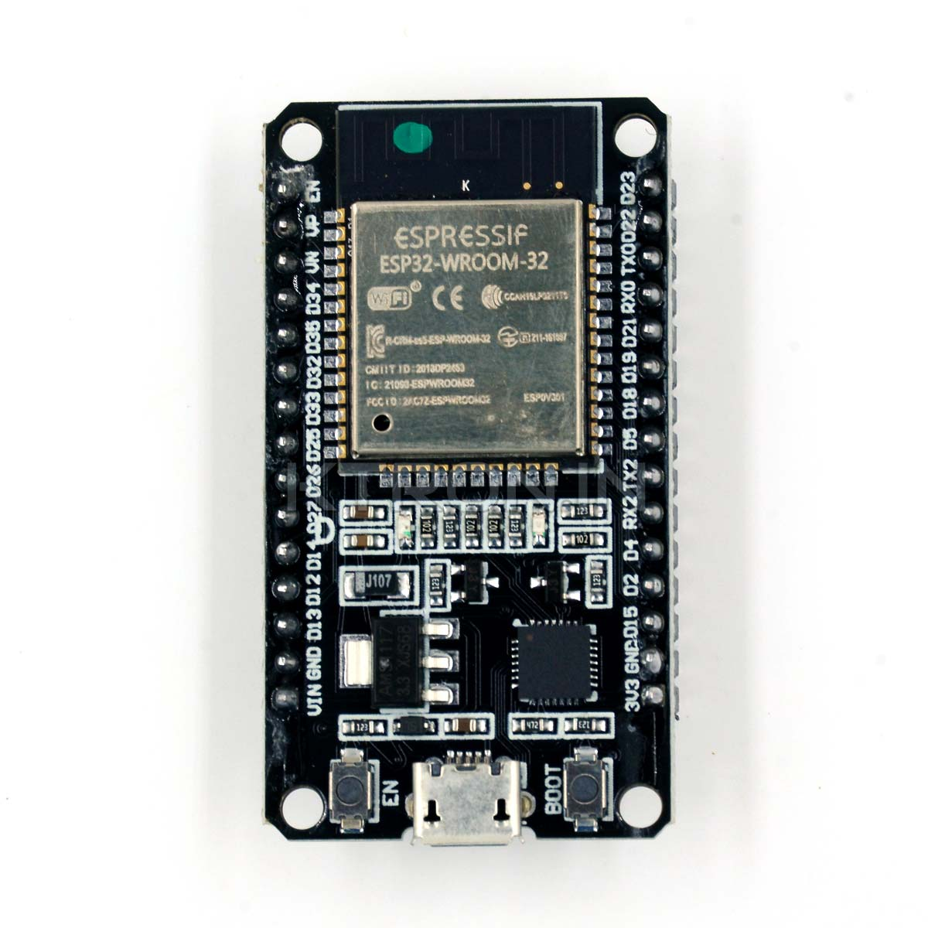
Descriptions of Sensors which are used
1 ESP32
The Node MCU ESP8266 development board comes with the ESP-12E module containing ESP8266 chip having Tensilica Xtensa 32-bit LX106 RISC microprocessor. This microprocessor supports RTOS and operates at 80MHz to160 MHz adjustable clock frequency. Node MCU has 128 KB RAM and 4MB of Flash memory to store data and programs. Its high processing power with in-built Wi-Fi / Bluetooth and Deep Sleep Operating features make it ideal for IOT projects.

Slide 13
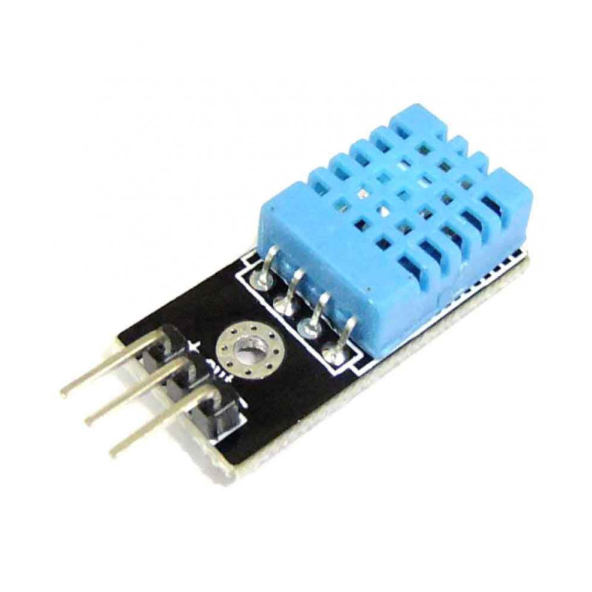
2 DHT11
The DHT11 is a commonly used Temperature and humidity sensor. The sensor comes with a dedicated NTC to measure temperature and an 8-bit microcontroller to output the values of temperature and humidity as serial data. The sensor is also factory calibrated and hence easy to interface with other microcontrollers. The sensor can measure temperature from 0°C to 50°C and humidity from 20% to 90%with an accuracy of ±1°C and ±1%.

Slide 14
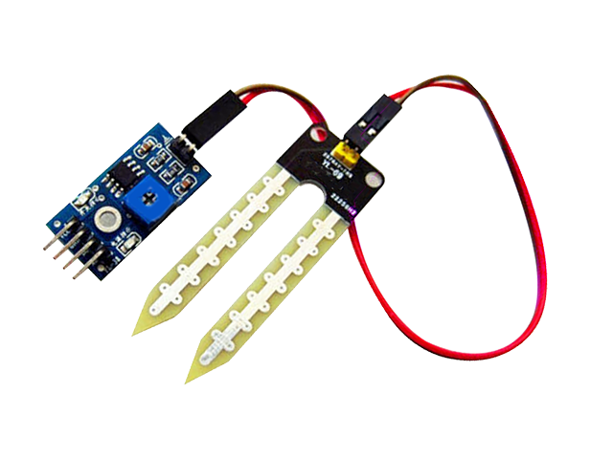
3 Soil Moisture Sensor
The soil moisture sensor is one kind of sensor used to gauge the volumetric content of water within the soil. As the straight gravimetric dimension of soil moisture needs eliminating, drying, as well as sample weighting. These sensors measure the volumetric water content not directly with the help of some other rules of soil like dielectric constant, electrical resistance, otherwise interaction with neutrons, and replacement of the moisture content.

Slide 15
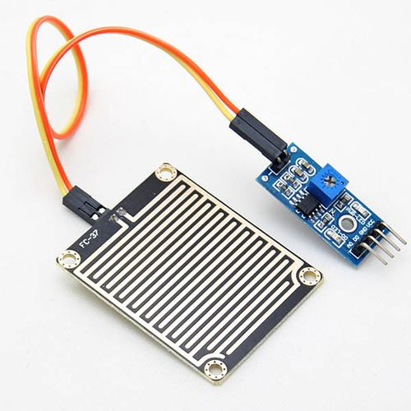
4 Rain Sensor
A rain sensor is a device that detects rainfall and triggers automated responses. It typically employs a series of electrodes or a moisture-sensitive element to detect the presence of water. When rain is detected, it sends a signal to systems like irrigation controllers to pause watering, enhancing water conservation efforts. Rain sensors are commonly used in both residential and commercial settings to optimize outdoor water usage.

Slide 16
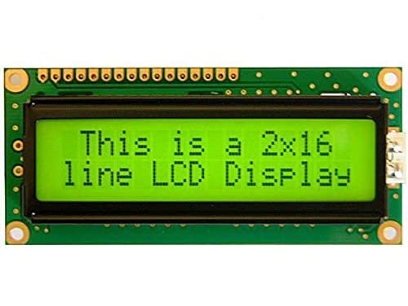
5 LCD Display (2* 16)
An LCD display 16x2 is a liquid crystal display with 16 characters in each of its two rows. It provides a compact yet informative output for various electronic projects and devices. These displays are commonly used in Arduino and Raspberry Pi projects for showing text-based information such as sensor readings, messages, or menu options. With its simplicity and versatility, it serves as a fundamental component in many embedded systems and DIY electronics.

Slide 17
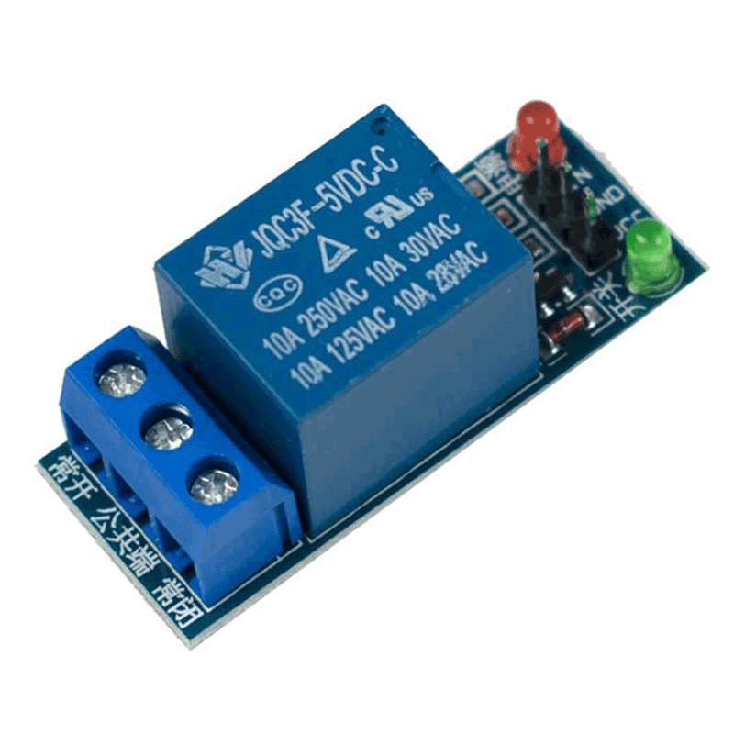
6 SPST Relay Module
Relay is an electromechanical device that uses an electric current to open or close the contacts of a switch. The single channel relay module is much more than just a plain relay, it comprises of components that make switching and connection easier and act as indicators to show if the module is powered and if the relay is active or not.

Slide 18
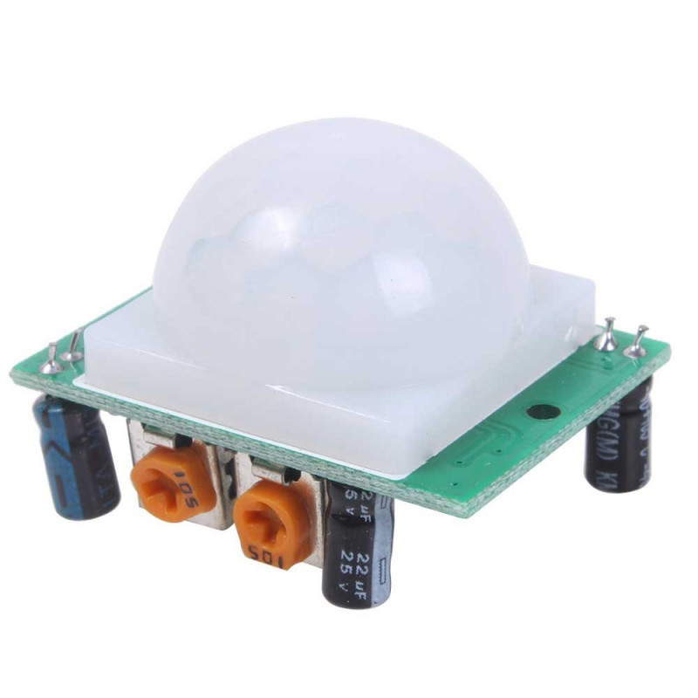
7 PIR Motion Sensor
The PIR sensor itself has two slots in it, each slot is made of a special material that is sensitive to IR. The lens used here is not really doing much and so we see that the two slots can 'see' out past some distance (basically the sensitivity of the sensor).When the sensor is idle, both slots detect the same amount of IR, the ambient amount radiated from the room or walls or outdoors. When a warm body like a human or animal passes by, it first intercepts one half of the PIR sensor, which causes a positive differential change between the two halves. When the warm body leaves the sensing area, the reverse happens, whereby the sensor generates a negative differential change.

Slide 19
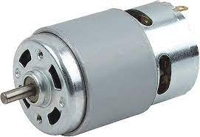
8 DC Motor 12V
A 12V DC motor is an electric motor designed to operate on a 12-volt direct current power supply. It converts electrical energy into mechanical energy to produce rotational motion. These motors are widely used in various applications including robotics, automotive systems, home appliances, and industrial machinery. Their voltage rating determines their speed, torque, and power characteristics, making them suitable for a range of tasks from precise control to high-power output.

Slide 20
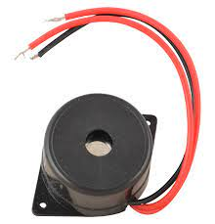
9 Buzzer
A buzzer is an electromechanical device that produces sound when an electrical current passes through it. It typically consists of a coil of wire and a vibrating diaphragm or a piezoelectric element. Buzzer's sound output can vary in pitch and intensity depending on its design and input voltage. Commonly used in alarms, timers, and electronic notification systems, buzzers provide audible alerts and signals in various applications.

Slide 21
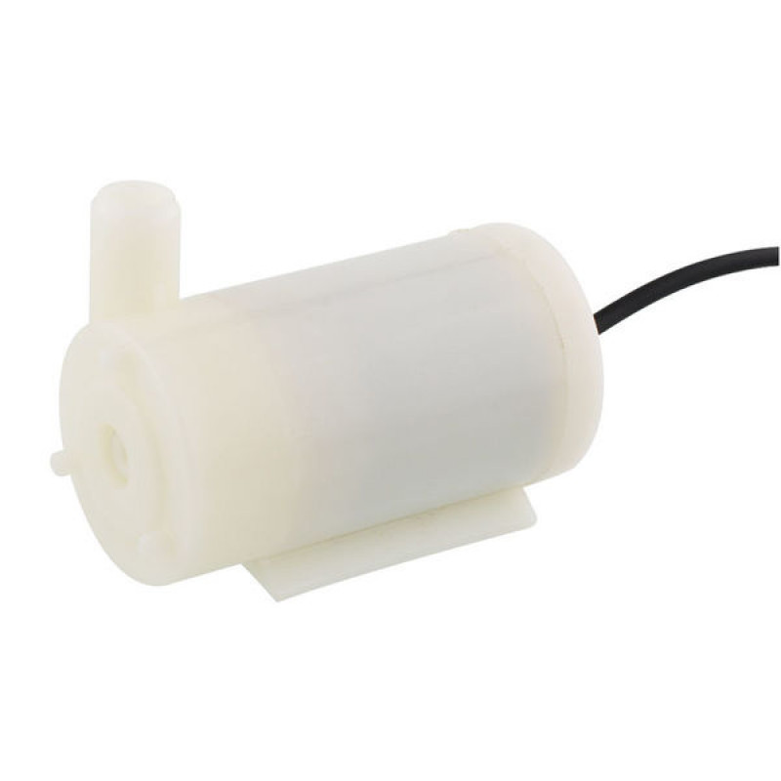
10 Water Pump
A water pump is a mechanical device used to move water from one location to another. It typically operates by creating suction or pressure to draw water through a pipe or hose. Water pumps are utilized in various settings including residential, agricultural, industrial, and commercial applications for irrigation, drainage, circulation, and water supply purposes. They come in different types such as centrifugal, submersible, and diaphragm pumps, each suited to specific needs and environments.

Slide 22
Our Solution in Action
1
Scenario Deployment
Visualizing a day in the life of a farm utilizing our IoT solution, witnessing the tangible benefits and operational ease in real-time.
2
Technical Efficacy
Spotlighting the seamless interplay between sensors, analytics, and action to demonstrate proactive farming at its finest.
3
Animated Insights
An animated journey that captures our IoT solution's dynamics, empowering farmers with revolutionary management capabilities.

Slide 23
START
TURN ON / OFF THE MOTOR USING TELEGRAM APP
CHECK FOR MOISTURE ,HUMIDITY,AIR QUALITY,RAINING
COMPARE THE VALUES
FARMER GETTING Email /RESULTS

Slide 24
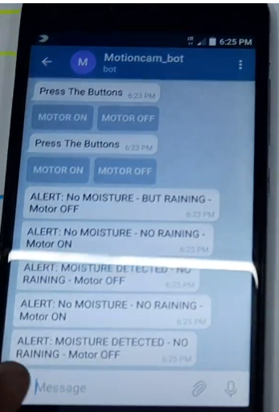
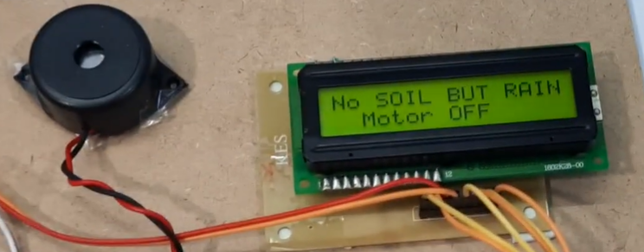
CONNECTION BETWEEN IOT AND HARDWARE

Slide 25

Features and Functionalities:
Data Collection & IoT Integration
USER FRIENDLY ASPECTS AND BENEFITS:
A simple and user-friendly interface that works well on both web and mobile applications.
Communicate transparently about the security measures in place to protect user data and ensure the system's reliability.
By prioritizing these user-friendly features and functionalities, a soil irrigation project can enhance user adoption, satisfaction, and overall success in promoting efficient and sustainable agricultural practices.
01
02
Remote Sensing &
Energy Efficiency
Decision Support Systems
05
03
Alerts and Notifications &
Mobile Accessibility
04
Soil Health Monitoring

Slide 26
Purpose of use of Data Analytics in Agriculture
Optimizing Crop Production: Data analytics can help farmers analyze various parameters such as soil moisture levels, temperature, humidity, and weather forecasts to optimize crop production. By analyzing this data, farmers can make informed decisions about irrigation scheduling, fertilization, and pest management, leading to higher yields and better quality crops.
Resource Management: ThingSpeak and similar platforms allow farmers to monitor resource usage such as water and energy more efficiently. By analyzing historical data on resource consumption and crop yields, farmers can identify trends and make adjustments to minimize waste and maximize resource efficiency.
Predictive Analytics for Pest and Disease Management: By analyzing data from sensors monitoring environmental conditions, pest populations, and crop health, farmers can predict potential pest outbreaks or disease outbreaks. Early detection enables proactive measures to be taken, such as targeted pesticide application or adjustments to crop management practices, reducing crop losses and minimizing the need for chemical inputs.
Remote Monitoring and Control: ThingSpeak facilitates remote monitoring of agricultural systems and enables farmers to control equipment such as irrigation systems or climate control systems from anywhere with an internet connection. This capability allows for real-time adjustments based on data analytics, improving operational efficiency and responsiveness to changing conditions
Decision Support Systems: Data analytics platforms like ThingSpeak can serve as decision support systems for farmers, providing insights and recommendations based on analyzed data. These insights can help farmers make more informed decisions about planting schedules, crop selection, and agronomic practices, ultimately leading to improved profitability and sustainability.
Research and Development: Aggregated data from multiple farms collected through platforms like ThingSpeak can be valuable for agricultural research and development. Researchers can analyze this data to identify trends, correlations, and best practices, leading to innovations in agricultural techniques, crop varieties, and technology adoption.

Slide 27
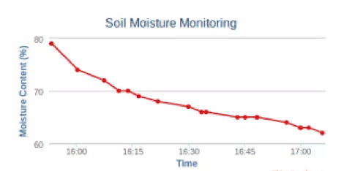
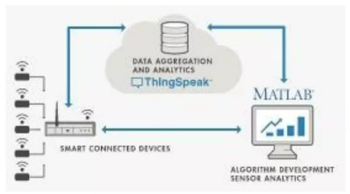
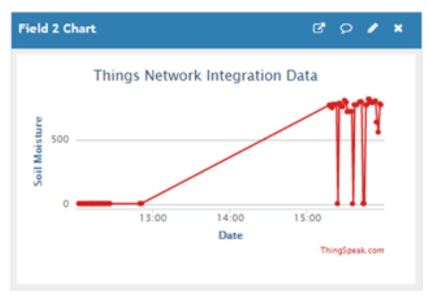
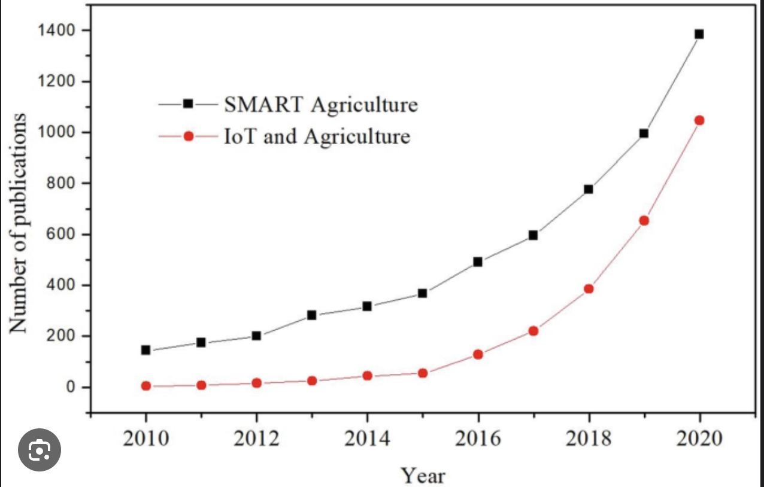

Slide 28
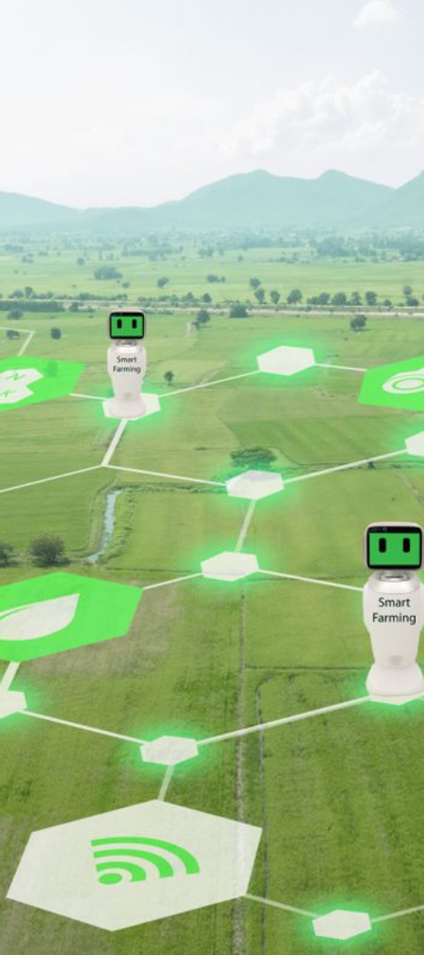
Transforming Farming Practices & Overcoming Technical Challenges(1/4)
Impactful Transformation
1
Our IoT solution heralds a new era in agriculture, resulting in improved yields, efficient resource use, eco-friendly practices, and ultimately a sustainable model of farming.
Technical Hurdles
2
We share our journey through developmental challenges, including integration issues and data security, and how our persistent innovation and adaptability led to triumphant solutions.

Slide 29
Transforming Farming Practices & Overcoming Technical Challenges (2/4)
Progressed Surrendered
By leveraging progressed information analytics and prescient modeling, our arrangement makes a difference agriculturists make data-driven choices with respect to planting, water system, fertilization, and bug control. This optimization guarantees that crops get the proper amount of inputs at the correct time, driving to more advantageous plants and moved forward yields.
3
Maintainability
By advancing hones such as trim revolution, cover editing, and coordinates bother administration, our arrangement contributes to the long-term maintainability of cultivating operations. These hones offer assistance move forward soil wellbeing, decrease disintegration, minimize dependence on manufactured inputs, and upgrade biodiversity on the cultivate. Moreover, by optimizing asset utilize and minimizing squander, our arrangement bolsters the in general objective of feasible horticulture.
4

Slide 30
Transforming Farming Practices & Overcoming Technical Challenges (3/4)
Asset Optimization
Through accuracy agribusiness methods, such as inaccessible detecting, GPS innovation, and robotized apparatus, our arrangement empowers agriculturists to optimize their utilize of assets such as water, fertilizers, and pesticides. For illustration, by accurately focusing on ranges that require water system or fertilizer, agriculturists can minimize squander and diminish their natural affect.
5
By and large, our arrangement enables ranchers with the devices and experiences they have to be improve efficiency whereas minimizing their natural impression. By moving forward surrender, optimizing assets, and advancing maintainability, it contributes to the progression of cultivating hones and the long-term reasonability of rural frameworks.

Slide 31
Transforming Farming Practices & Overcoming Technical Challenges (4/4)
Technical Challenges:
Specialized Obstacles:
These include issues with coding, integration, compatibility, and adaptability.
Asset Imperatives:
Constrained budget, time, and labor can hinder advance.
Quality Confirmation:
Guaranteeing the item meets quality benchmarks in the midst of tight plans can be challenging.
Reliance Issues:
Depending on outside advances, APIs, or third-party administrations can present vulnerabilities and conditions.
How our team overcame the challenges:
We optimized asset allotment by prioritizing assignments, utilizing accessible instruments and innovations proficiently, and investigating cost-effective arrangements. Also, clear communication with partners guaranteed arrangement of desires with accessible assets. By prioritizing quality from the start and including quality confirmation pros early on, we minimized revamp and conveyed a vigorous item on plan. By embracing a proactive and collaborative approach, the improvement group effectively explored these challenges, conveying a high-quality item inside the characterized imperatives and surpassing partner desires.

